Slide 1
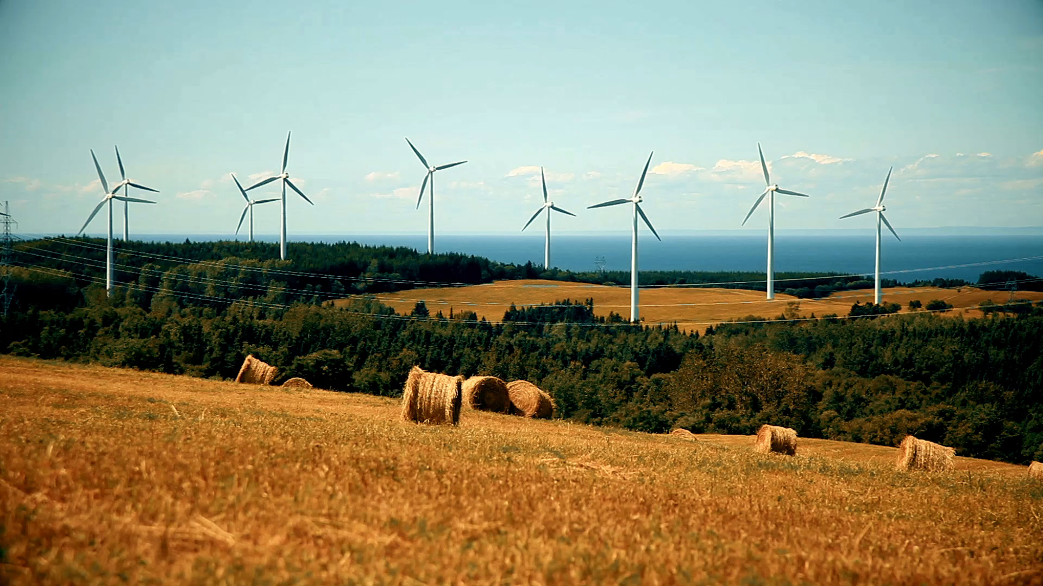
Renewable Energy Analysis
Portfolio Project
Highlighting the importance of carbon dioxide reduction and the growth of the renewable energy sector (1965-2022 World)
From Data Analyst Group 2 _ Stackfuel Training School GmbH 2023

Slide 2
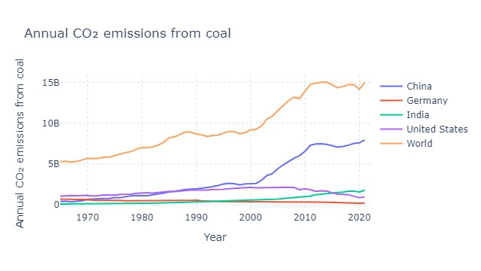
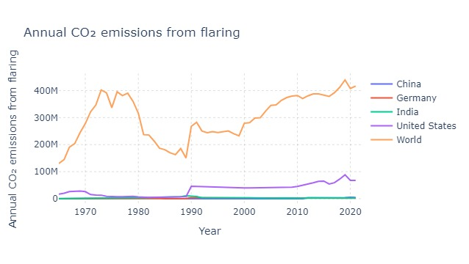
Annual Emission CO2 coal and flaring (tons)

Slide 3
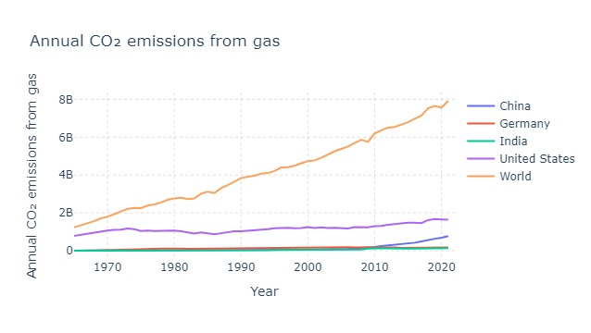
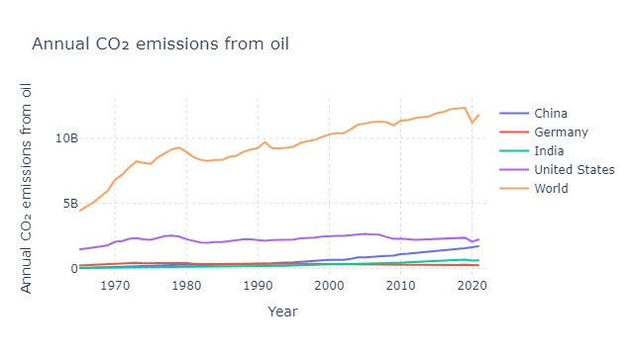
Annual Emission CO2 Gas and Oil (tons)

Slide 4
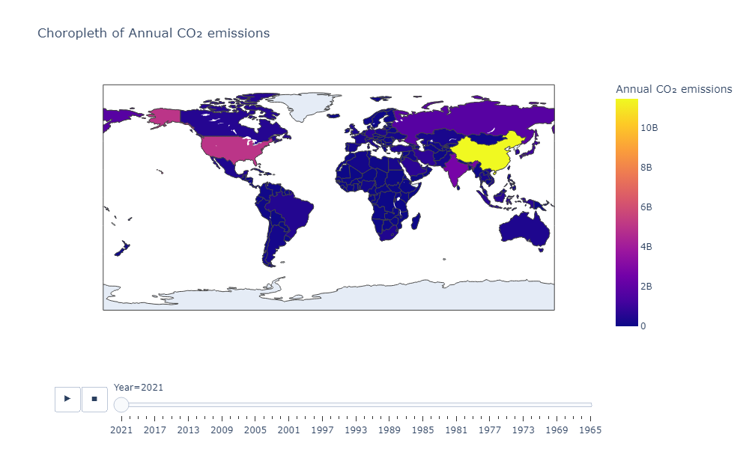
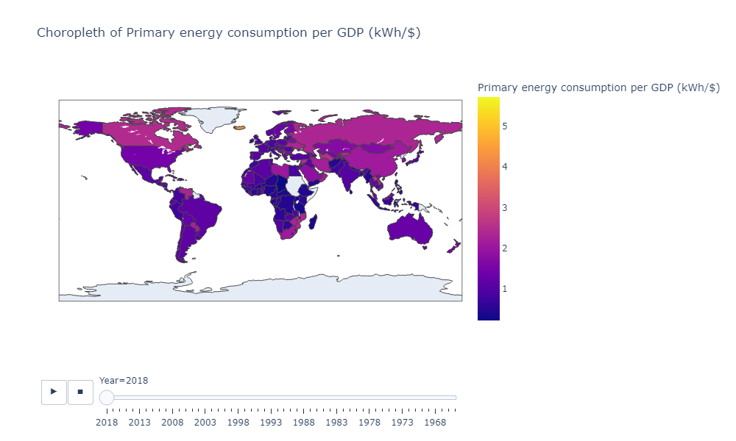
Total Annual of Emission in the World, 1965-2022

Slide 5
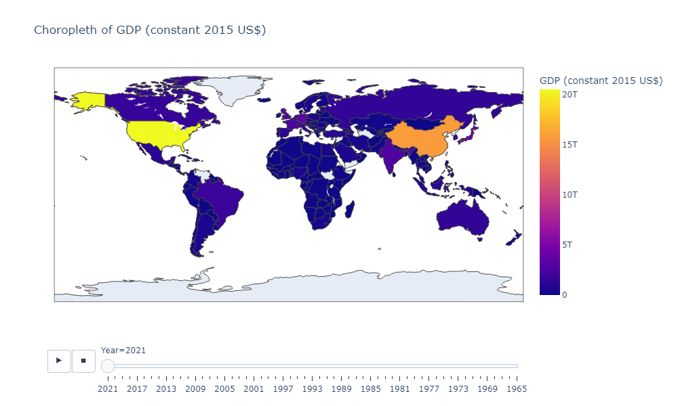
GDP in the World, 1965-2022 (Us Dollars)

Slide 6
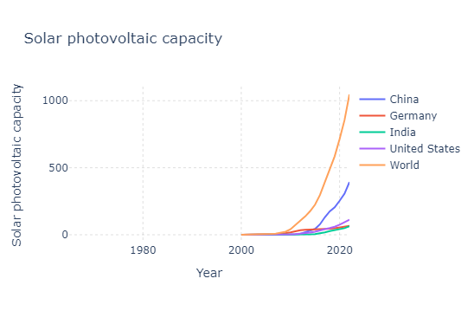
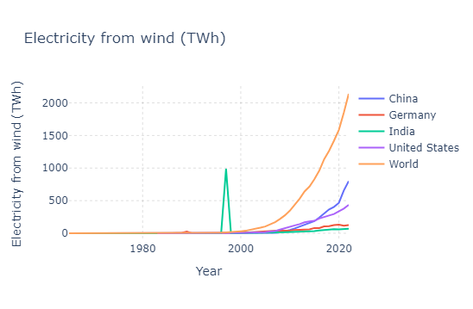
Electricity Production from Wind Energy and Solar Photovoltaic (tons)

Slide 7
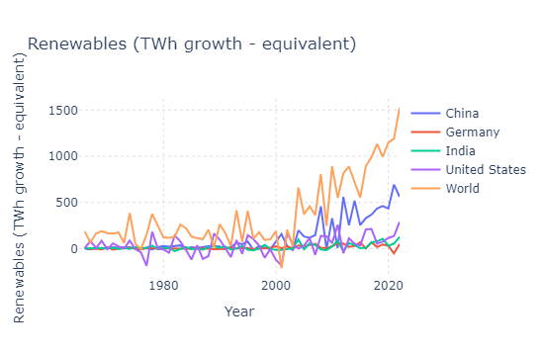
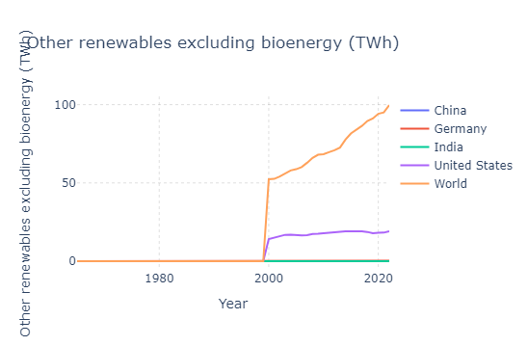
Others Renewable Energy excluding Bioenergy and Renewable (TWh Growth-equivalent)

Slide 8
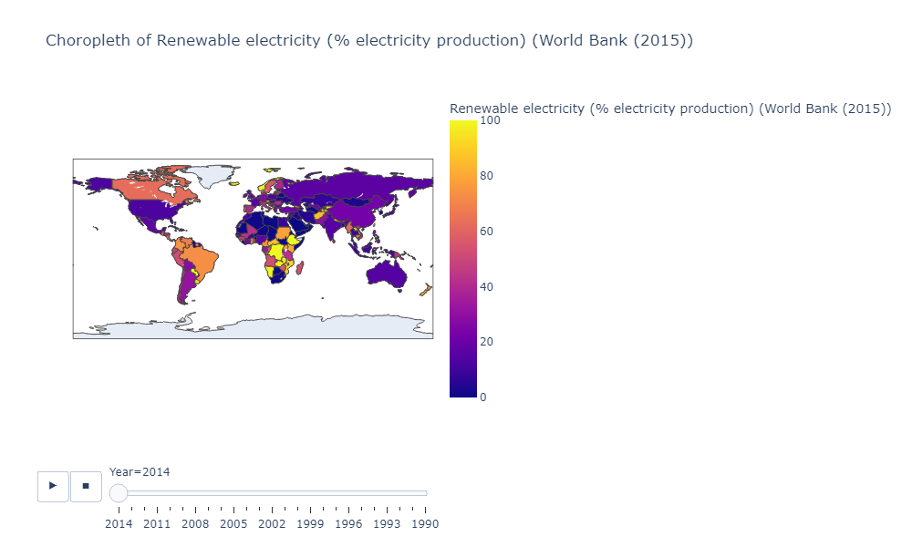
Renewable Electricity Production (percent)

Slide 9
Conclusion
We suggest that in future more AI machine learning projects in Clean Energy Family tree could solve Our Renewable energy problem.
Thermostat (AI device for home) – electricity usage can be monitored. Software, machine learning and AI come into play to help pave the way towards a low-emissions future.
A Deep Learning Model for Forecasting Photovoltaic Energy with Uncertainties – Computer Engineering, Virginia Commonwealth University.
Deep Reinforcement Learning for Optimal Energy Management of Multi-energy Smart Grids- Research University Bousnina D.,
Tilting at Turbines could be the future of Wind Turbines
Discovery of turning humidity (Humidity Batteries) into electricity which doesn’t have any emission could also change the future of Hydro plants.
Wave power with AI machines is also in the research phase which also adds up to emission free power production.

